Slide 1


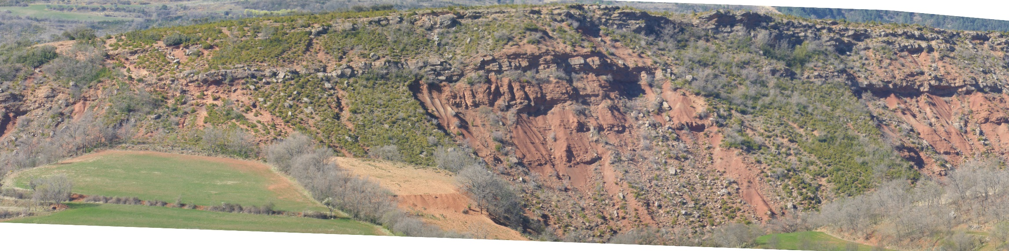
FAKTS overview & update – January 2021
Luca Colombera
Tremp Gp., Spanish Pyrenees

Slide 2


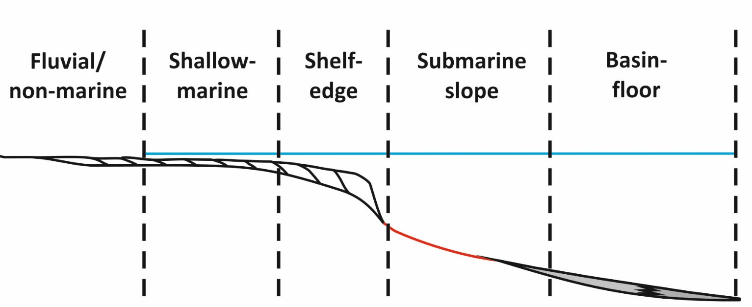
Leeds’ analogue databases
Development of a suite of relational databases for the quantitative characterization of sedimentary architecture of clastic depositional systems.
Applied as:
Research tools for quantitative sedimentology and stratigraphy
Resources for subsurface studies, applicable in contexts of exploration, appraisal and production
FAKTS
DASA
SMAKS
DMAKS
Team:
Luca Colombera
Grace Cosgrove
Soma Budai (RA)
Roman Soltan (RA)
Laura Bührig (PhD)
Bassam Alshammari (PhD)
Nigel Mountney
Bill McCaffrey
2010-now
2015-now
2015-now
(DWAKB in 2003; Baas et al. 2005)

Slide 3
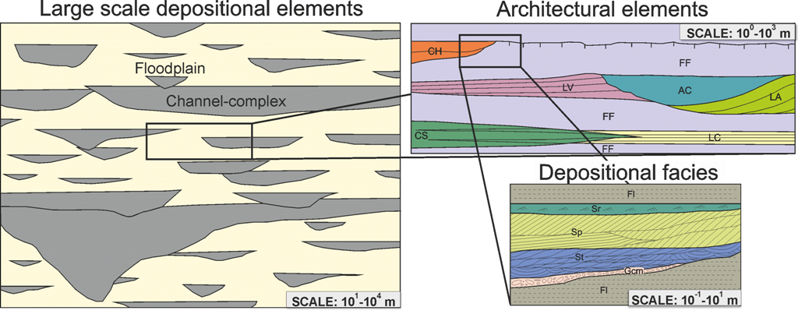
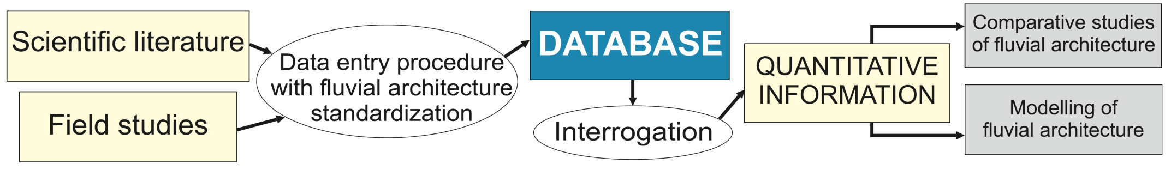
Database overview
The Fluvial Architecture Knowledge Transfer System (FAKTS) is a relational database for the digitization of the sedimentary and geomorphic architecture of modern and ancient fluvial depositional systems.
Fluvial architecture is translated into FAKTS as geological objects at different scales of observation, nested in a hierarchical fashion.
FAKTS database

Slide 4
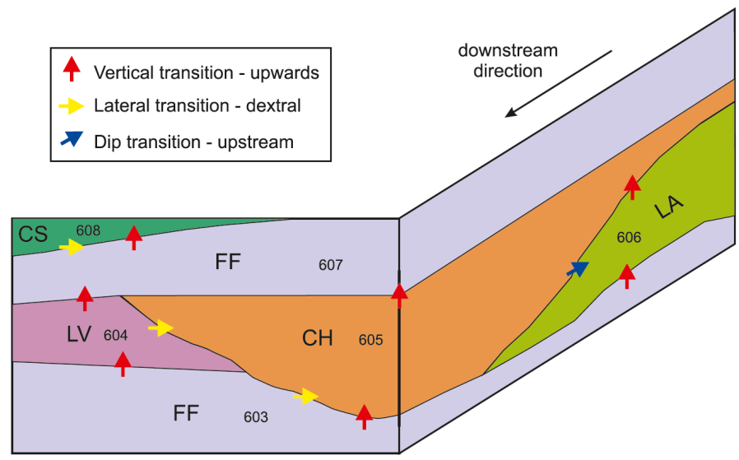
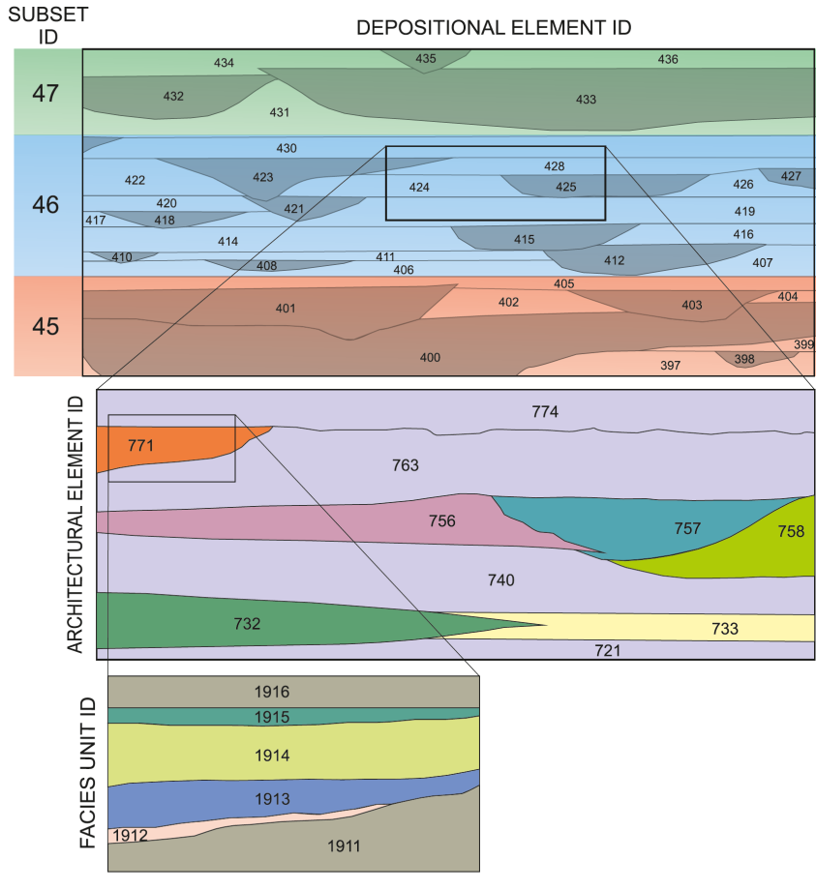
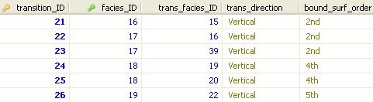
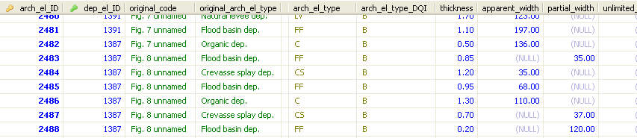
FAKTS implementation
Each rank of units is assigned to a table and each individual object is given a unique identifier, used to track hierarchical relationships.
Colombera et al.
(2012, Petrol. Geosc.)
The same numerical indices are also used for tracking neighbouring relationships between units of the same rank.
Colombera et al. (2012, Petrol. Geosc.)

Slide 5
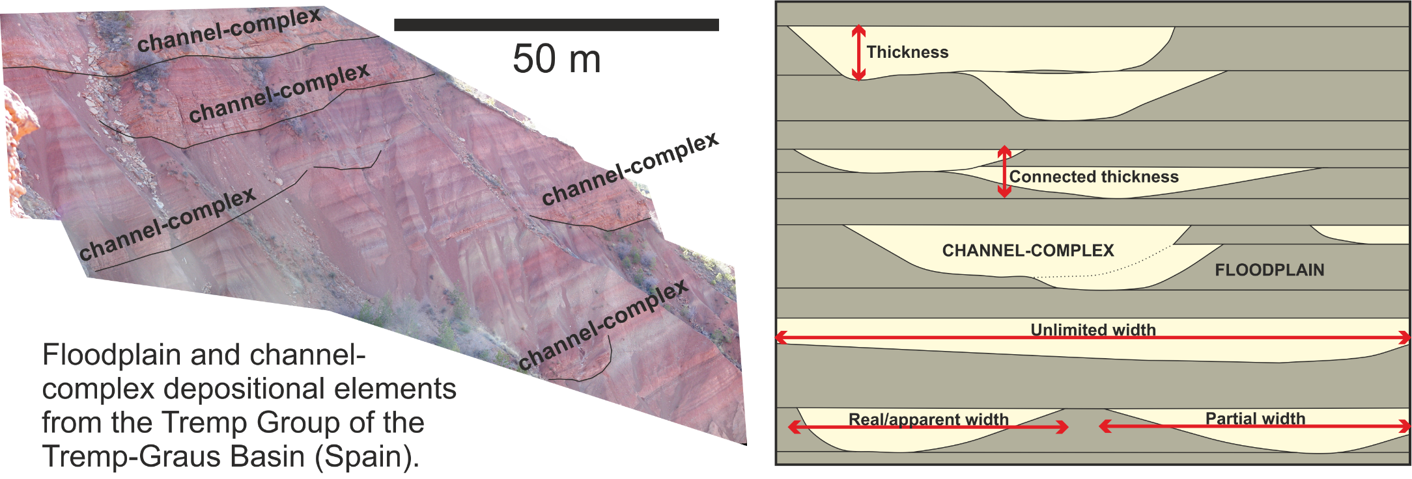
Genetic-unit classification
Farrer Fm.
(Utah)
FAKTS implementation
DEPOSITIONAL ELEMENTS
2 classes:
Channel complexes: discrete bodies of channel deposits, rather than genetically defined units
Floodplain elements: geometrically defined packages that neighbour channel complexes

Slide 6
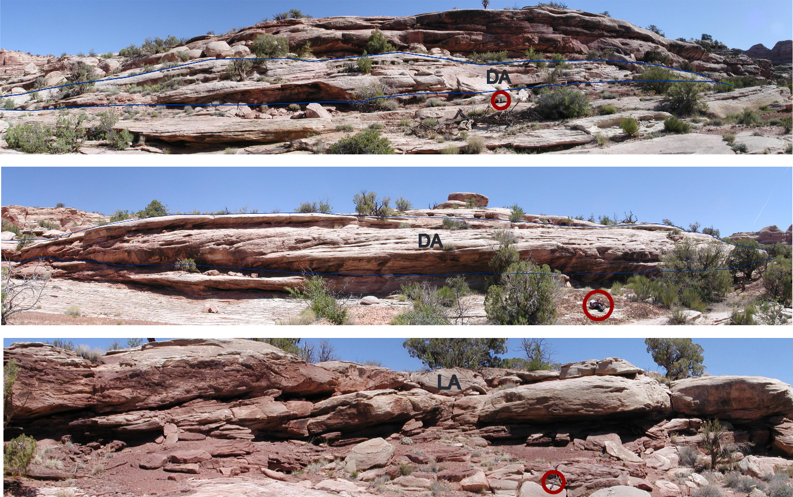
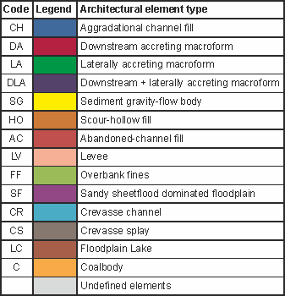
Genetic-unit classification
FAKTS implementation
ARCHITECTURAL ELEMENTS
14 interpretive classes of sub-environments, commonly with geomorphic expression. Modification of scheme by Miall (1996)
Barform types from the Lower Jurassic Kayenta Fm. (SE Utah)

Slide 7
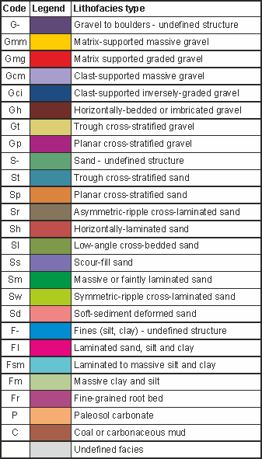
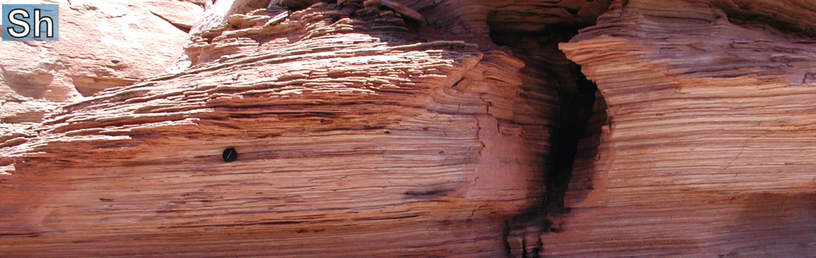
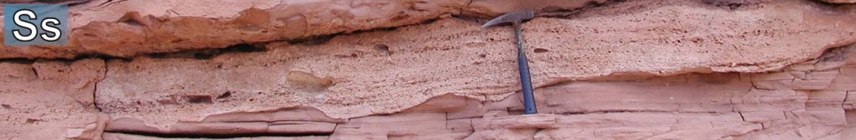
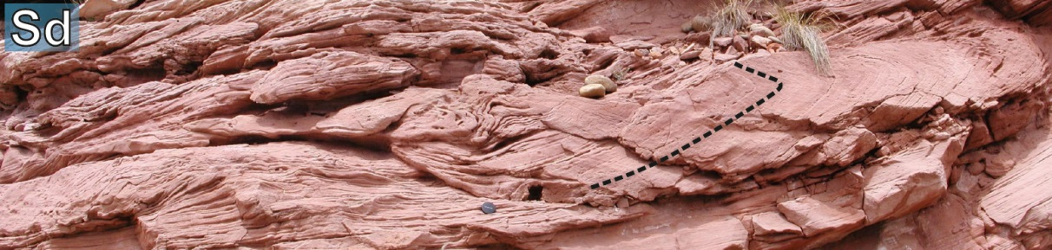
Genetic-unit classification
Farrer Fm.
(Utah)
FAKTS implementation
FACIES UNITS
Units bounded by second-order or higher-order bounding surfaces, characterized by given textural and structural properties. 25 textural ± structural classes.
Modification of scheme by Miall (1996)

Slide 8
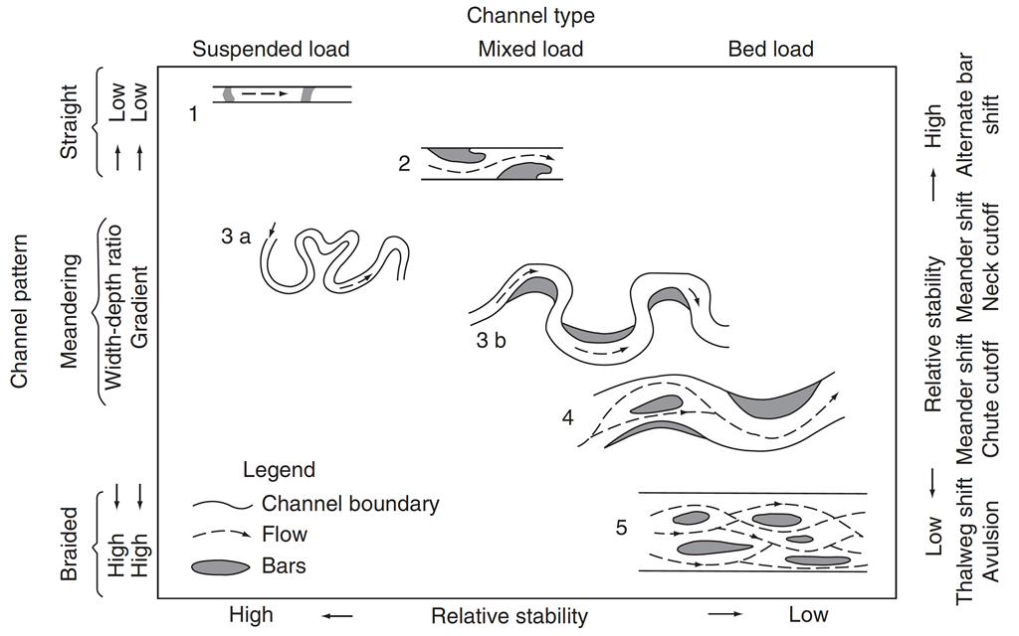
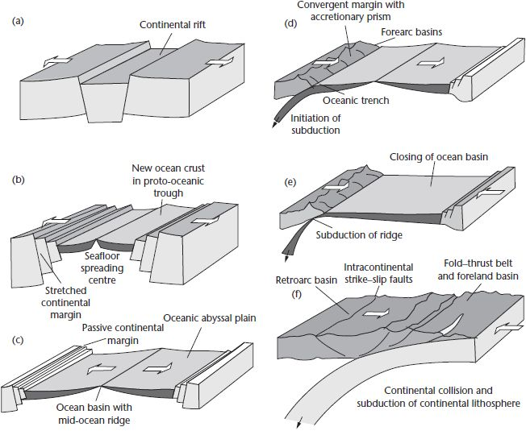
DATASET/SUBSET classification
FAKTS implementation
INTERNAL PARAMETERS
EXTERNAL CONTROLS
METADATA
Authors
Basin
Lithostratigraphic unit
River
Data types/quality
etc.
Basin gradient
River pattern
Drainage pattern
Aggradation rates
Relative distality
etc.
Subsidence rate/types
Basin/catchment climate
Basin/catchment vegetation
Relative eustatic change
Catchment lithologies
etc.
Schumm (1981)
Allen & Allen (2005)

Slide 9
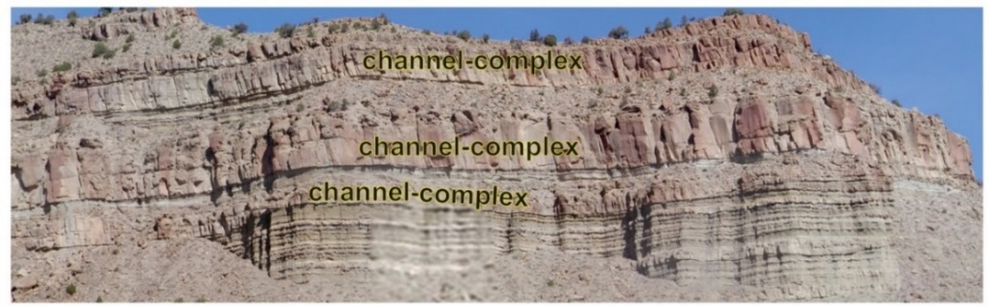
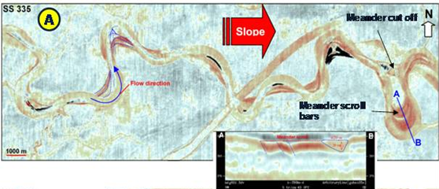
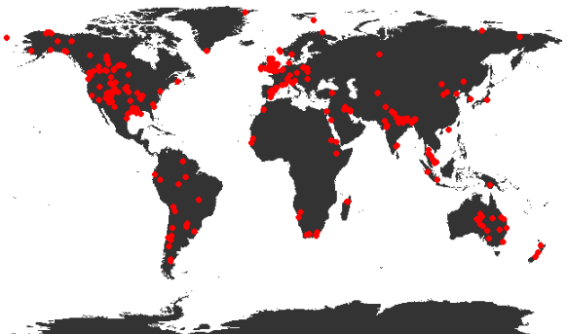
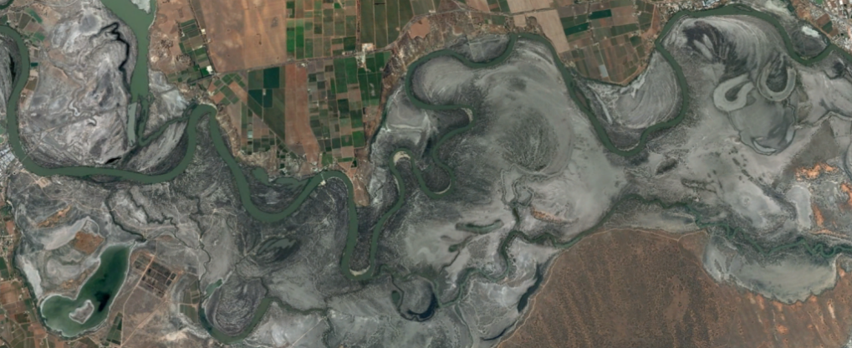
FAKTS content
347 case studies
160+ ancient succession, 130+ rivers
92,000+ classified genetic units:
15,000+ classified depositional elements
17,000+ classified architectural elements
60,000+ classified facies units
Ancient systems – outcrop
Farrer Fm.
(Utah)
Ancient systems – subsurface
Fachmi & Wood (2005)
Modern systems
Murray-Darling River

Slide 10
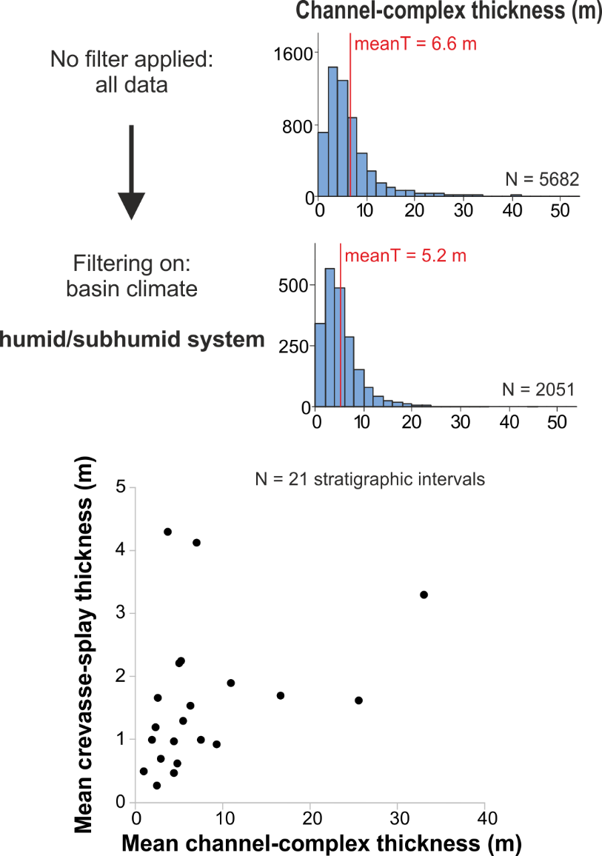
GENETIC-UNIT GEOMETRIES
FAKTS output
GENETIC-UNIT spatial relations
CREVASSE-SPLAY (CS)
ARCHITECTURAL ELEMENTS
–
TRANSITION STATISTICS

Slide 11
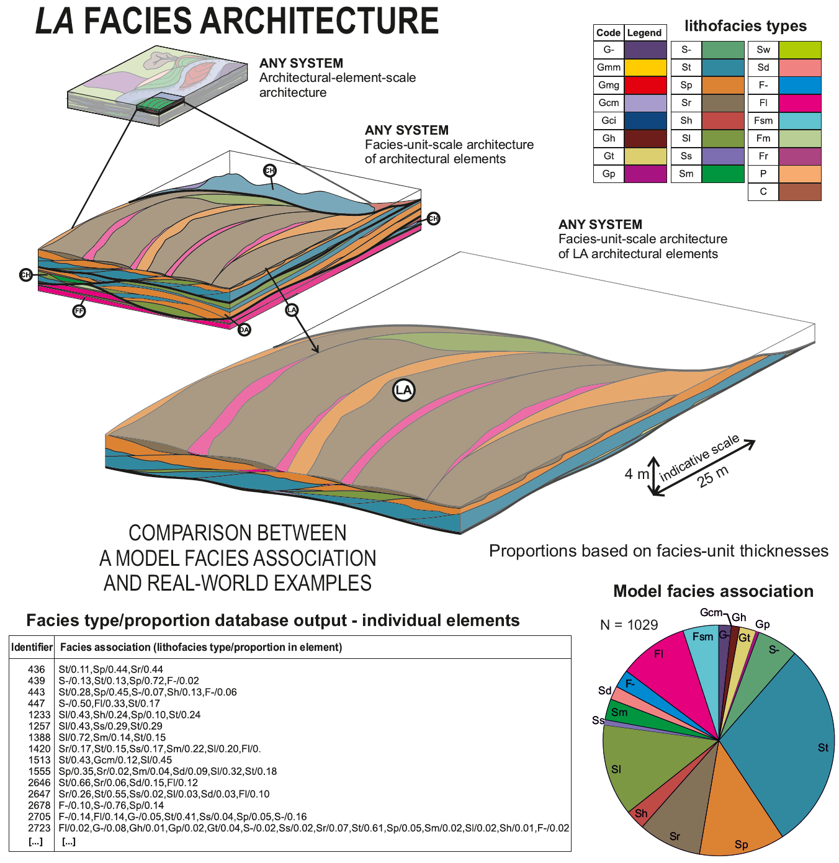
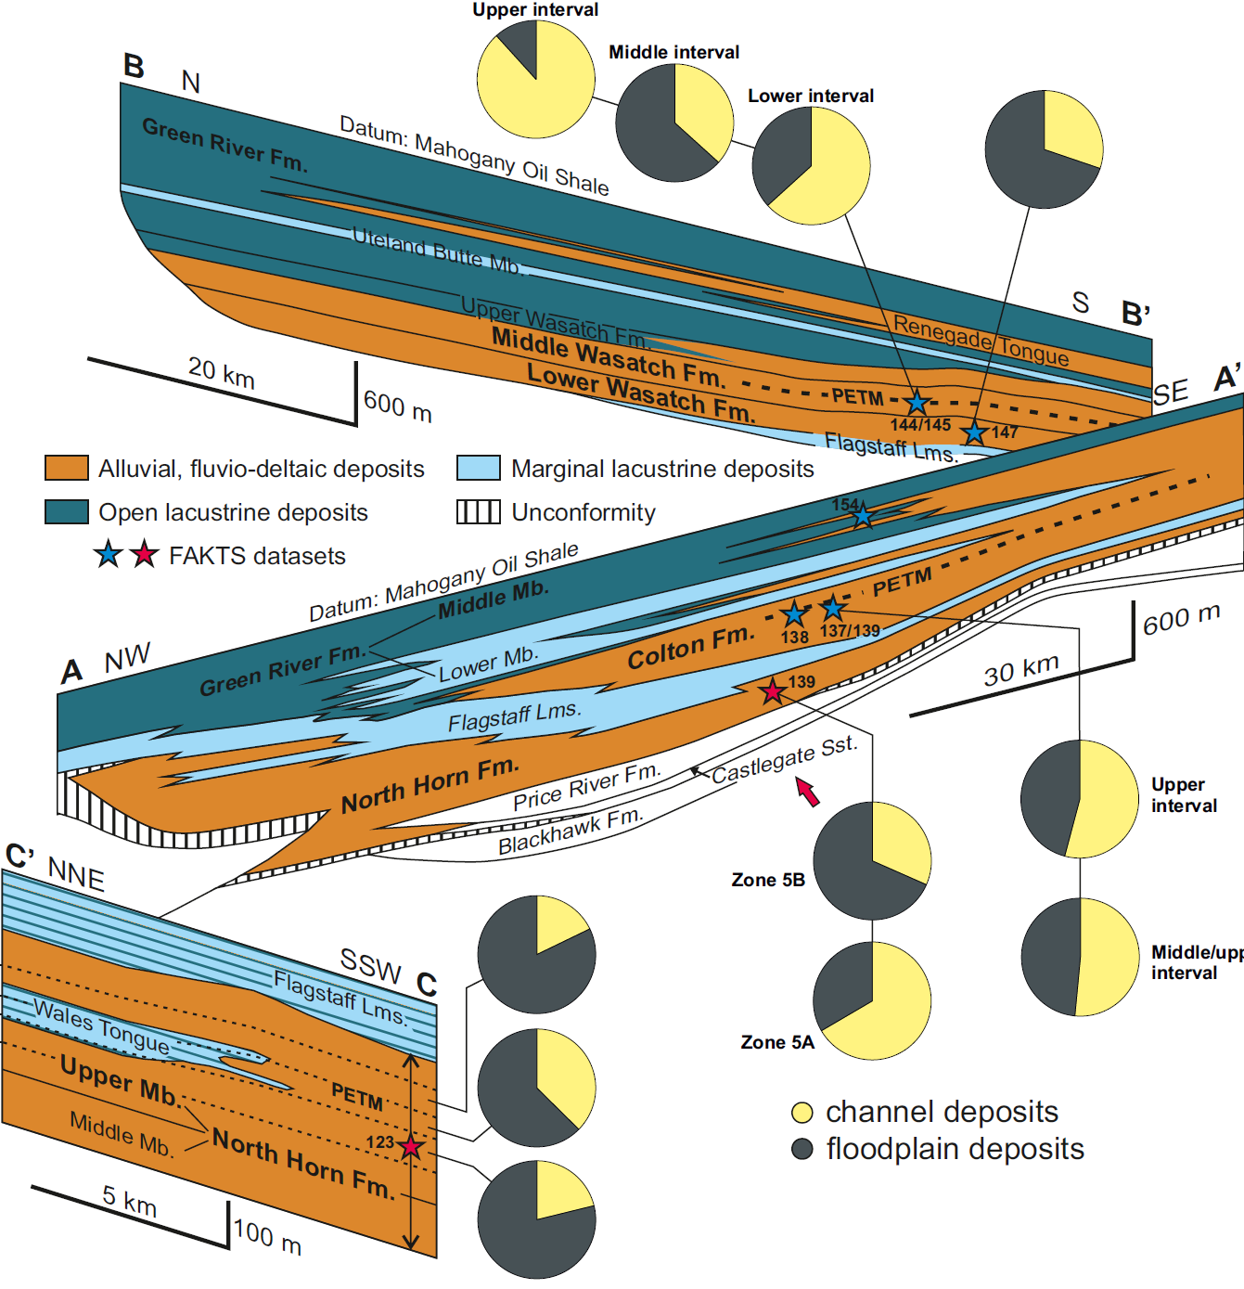
GENETIC-UNIT PROPORTIONS
FAKTS output
Spatial and temporal changes
Uinta Basin (Utah, USA)
All FAKTS output can be filtered on:
1) geological attributes on which systems are classified, 2) sedimentological data, 3) metadata → creation of facies models.

Slide 12
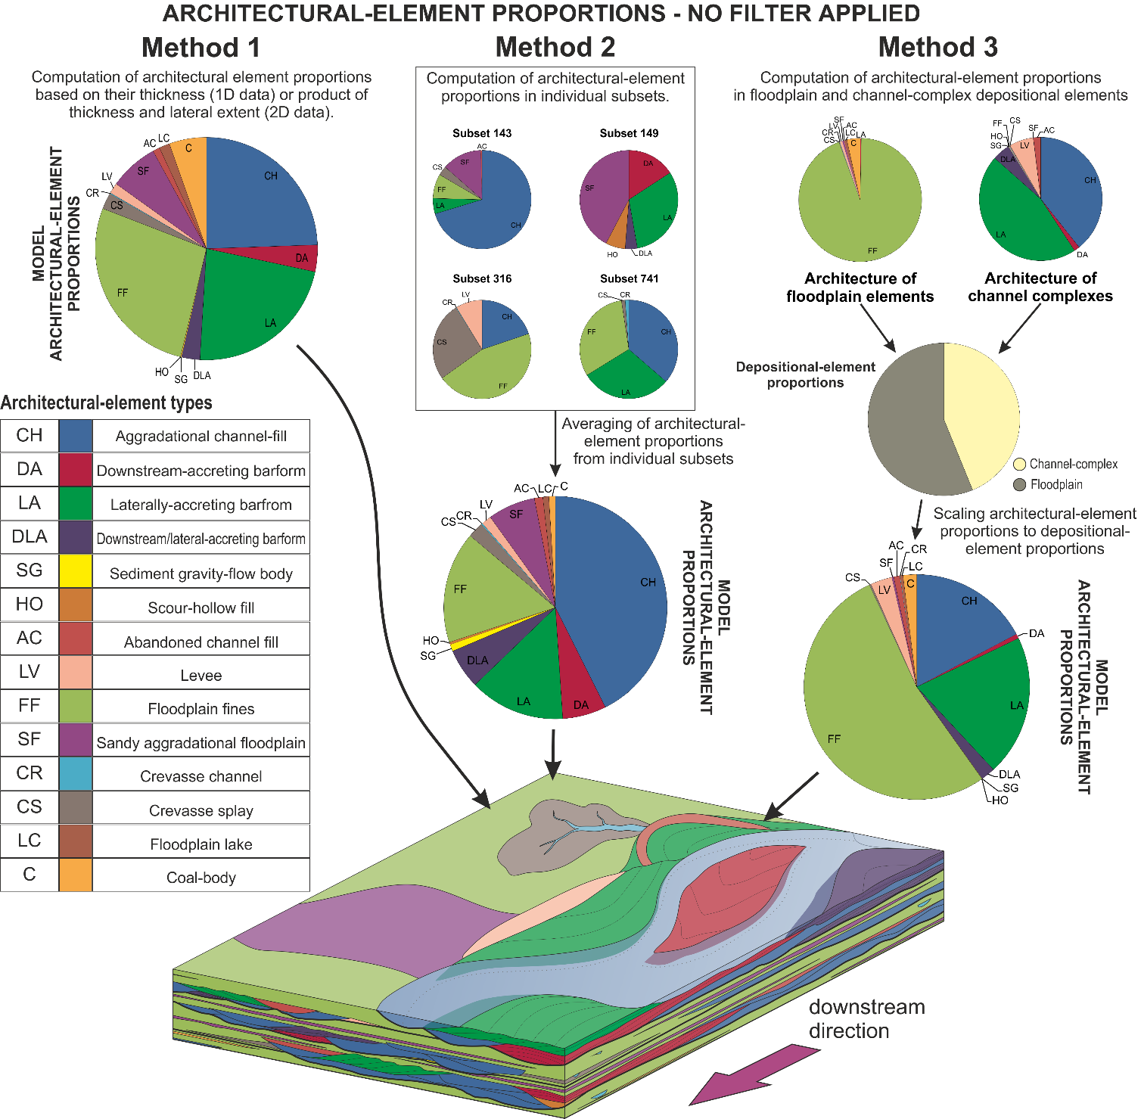
GENERATION OF QUANTITATIVE FACIES MODELS
FAKTS facies models
Model categorization:
through FAKTS filtering on:
- system parameters (e.g. braided planform; fluvial fan), and/or
- architectural properties (e.g. gravel-dominated, high NTG), and/or
- sub-environment type (e.g. point- bar, crevasse splay).
Distillation of information on genetic-unit proportions, geometries, hierarchical relationships, spatial relationships and stratigraphic distribution.
Colombera et al.
(2013, Sedimentology)

Slide 13
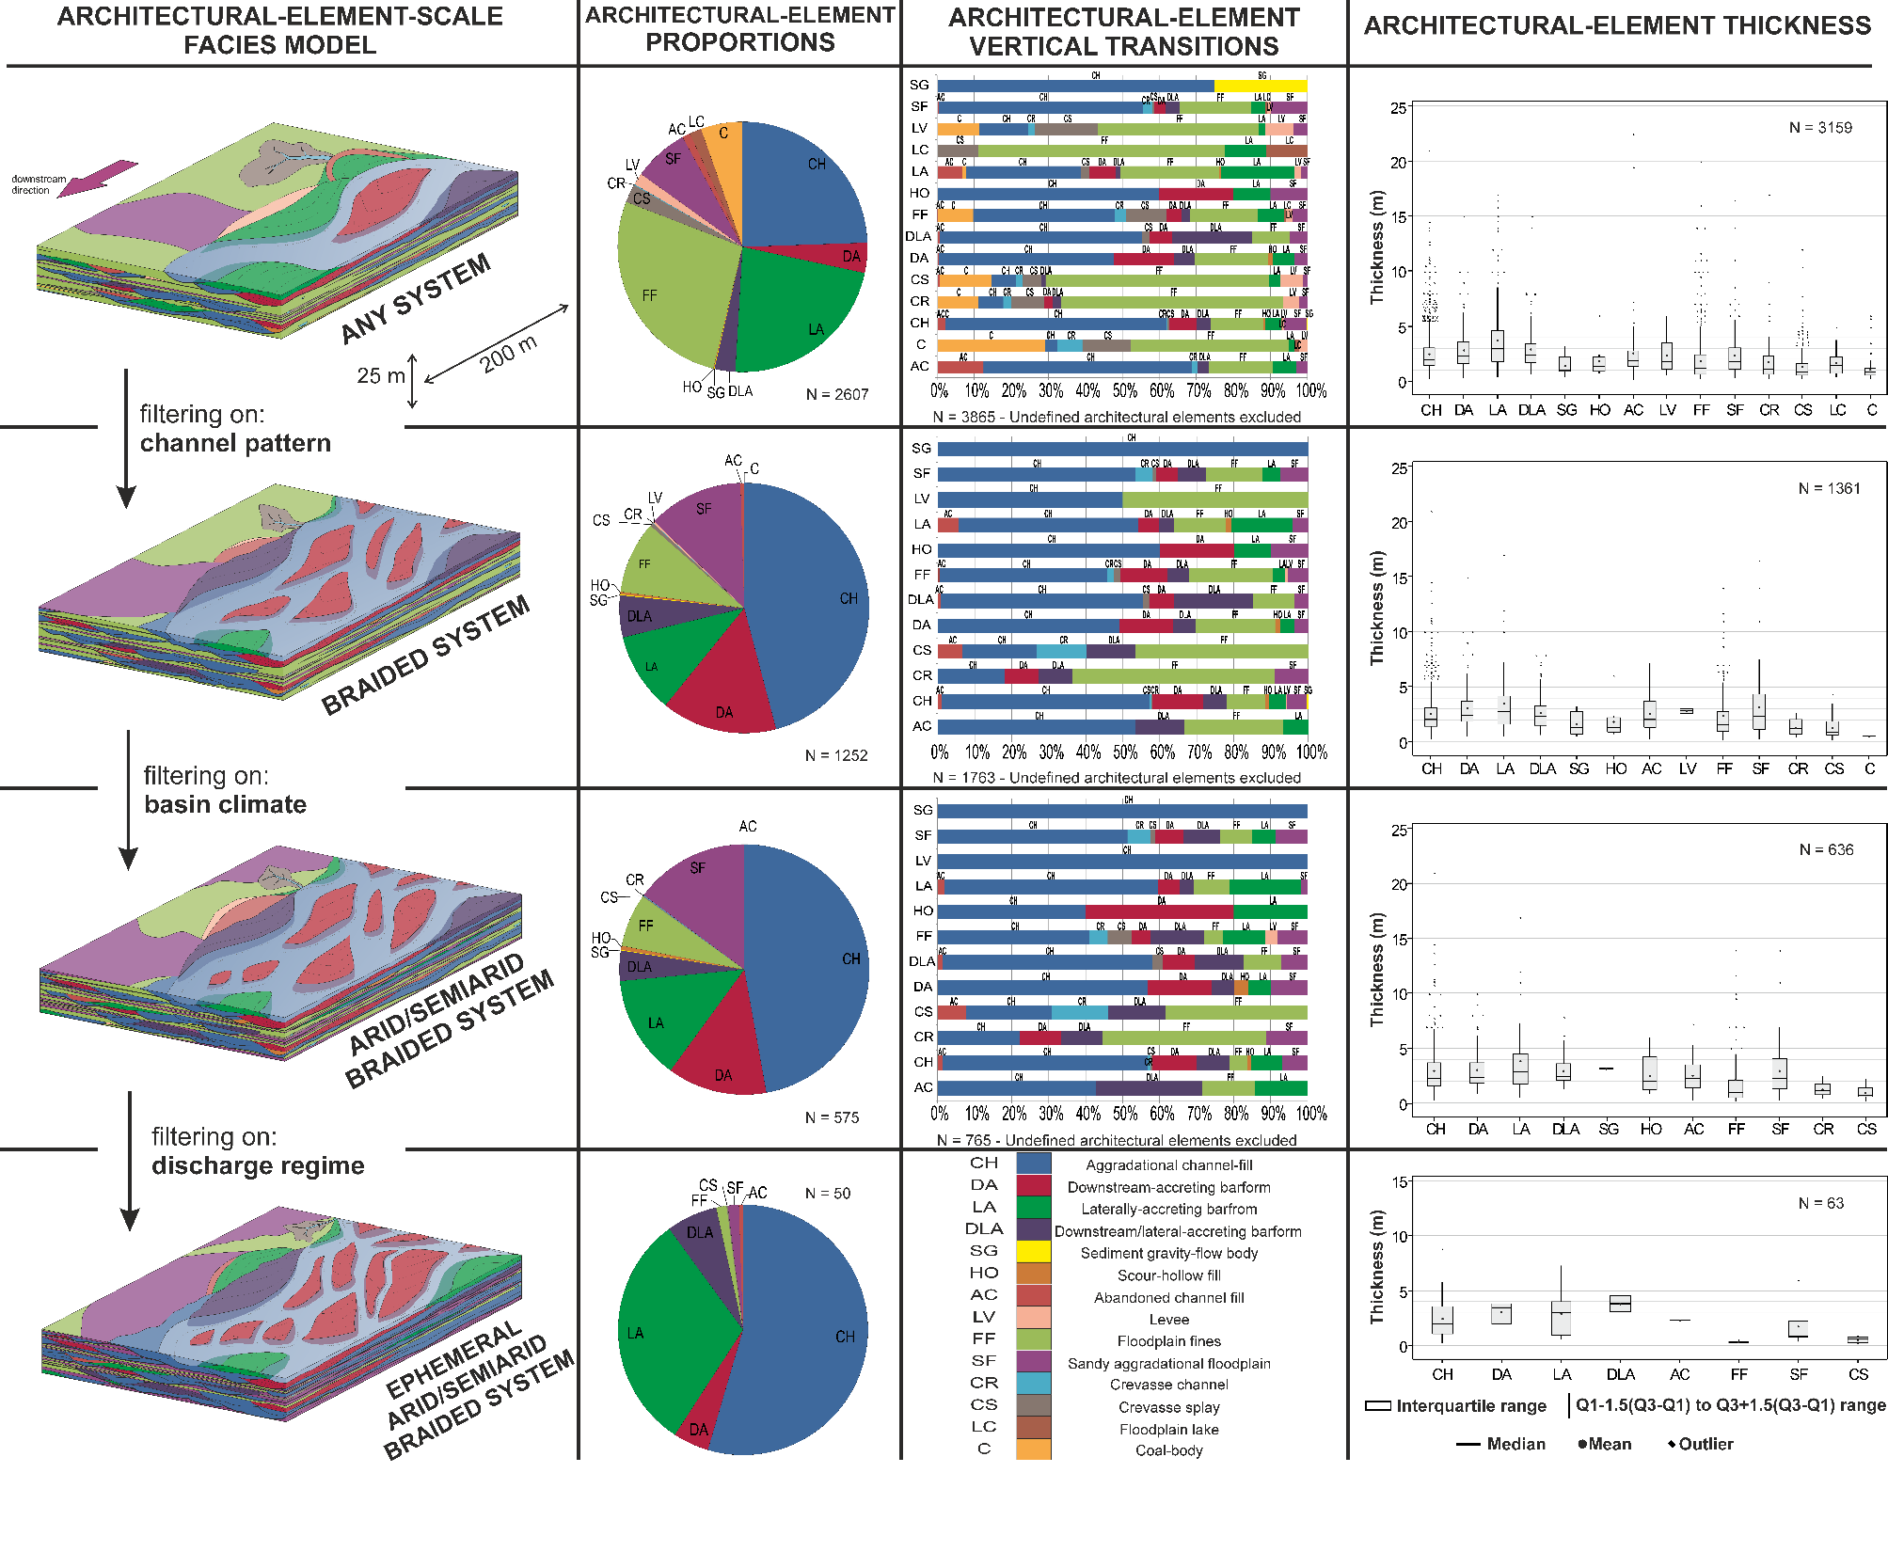
GENERATION OF QUANTITATIVE FACIES MODELS
FAKTS facies models
Database filtering
▼ ▼ ▼
Distillation of information on genetic-unit proportions, geometries, hierarchical relationships, spatial relationships and stratigraphic distribution.

Slide 14
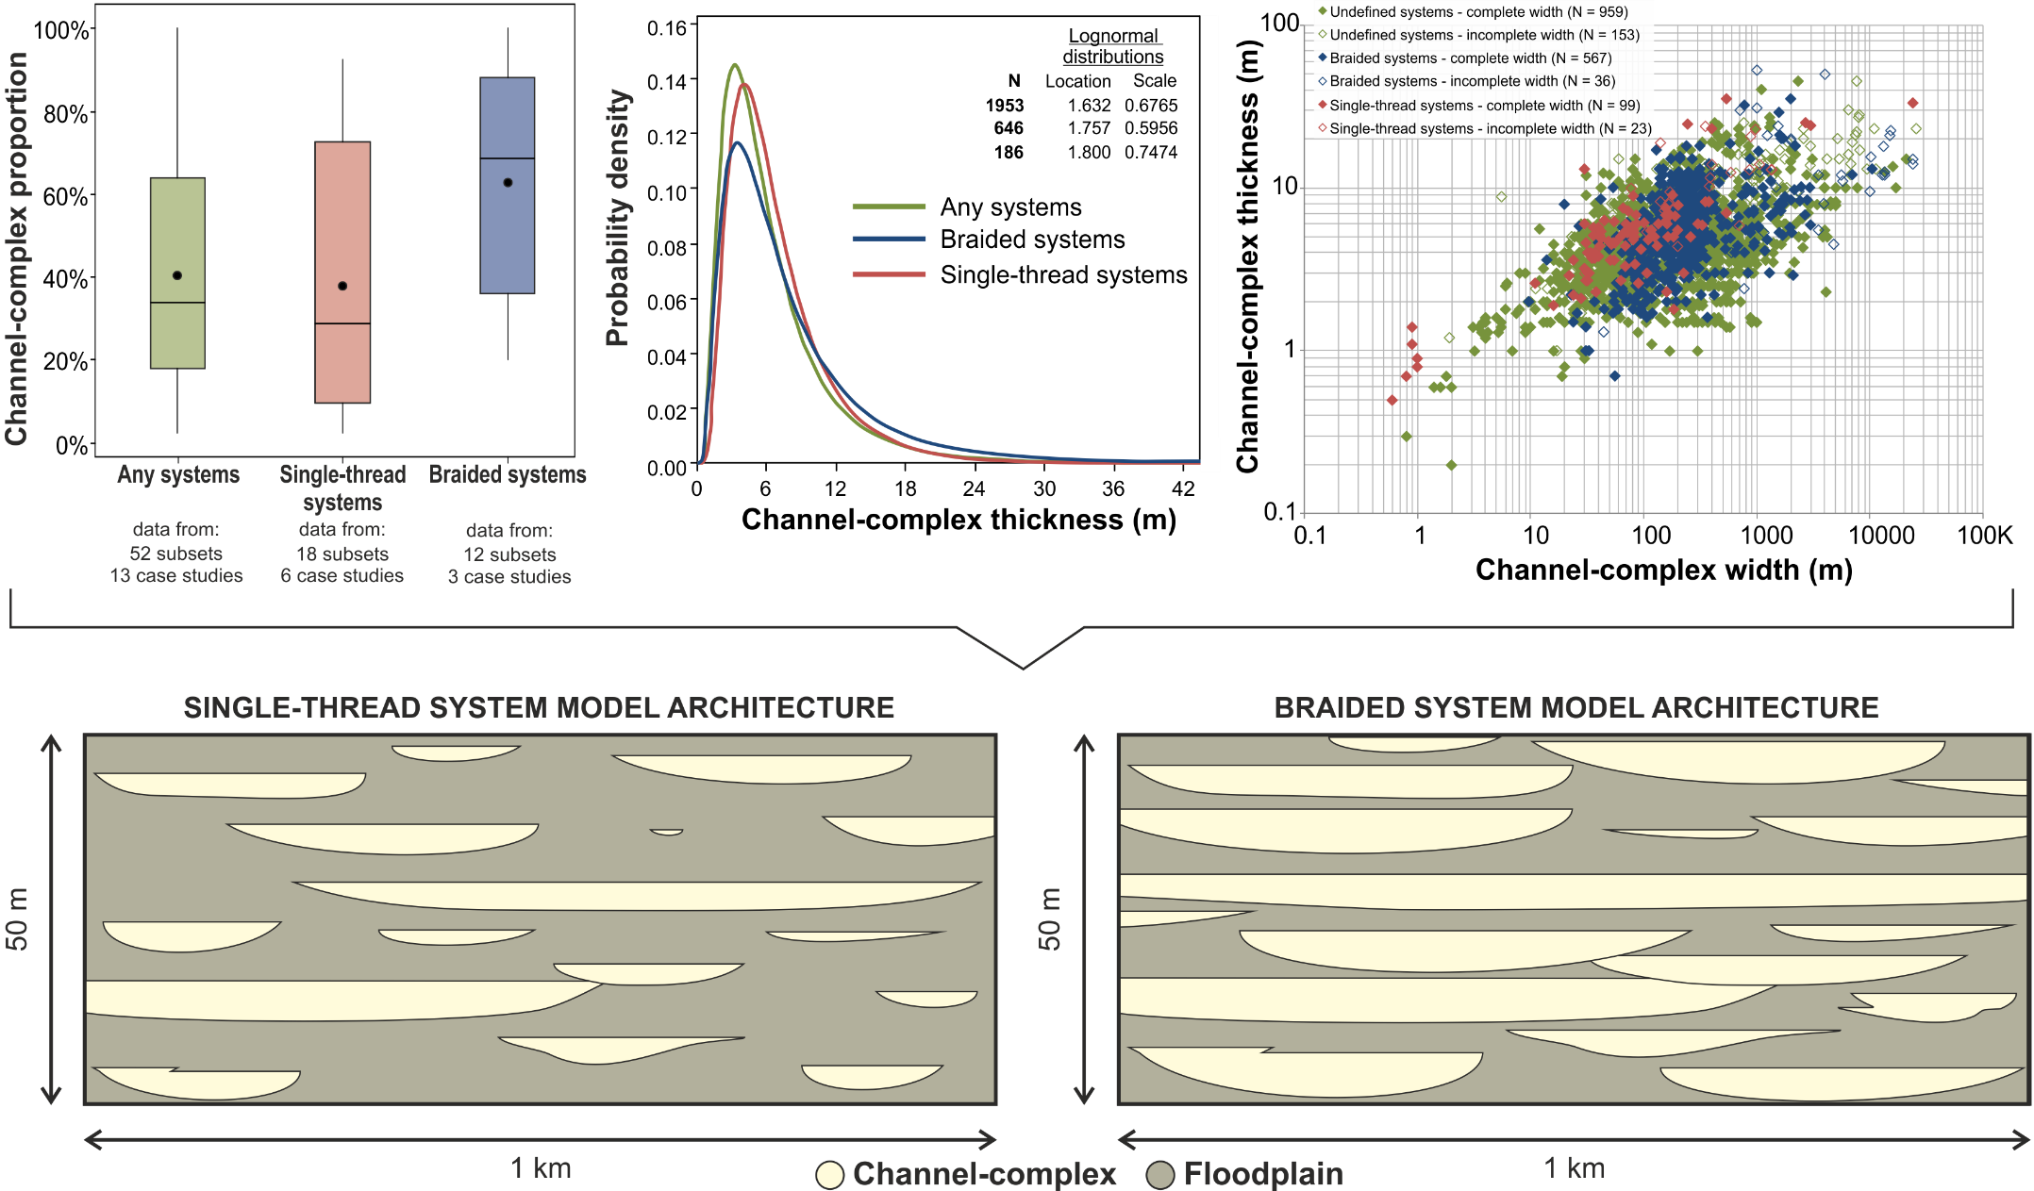
FAKTS facies models
FAKTS facies models can be tailored to different scales of interest.
Colombera et al. (2013, Sedimentology)

Slide 15
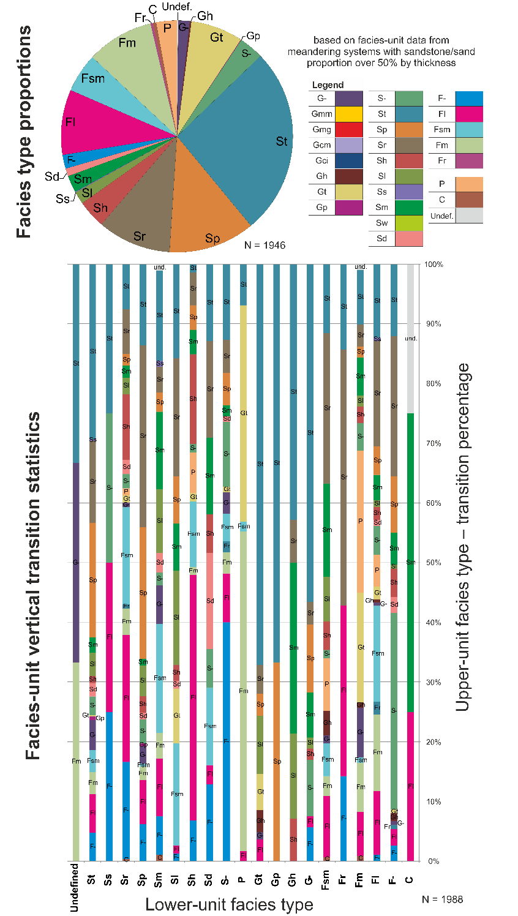
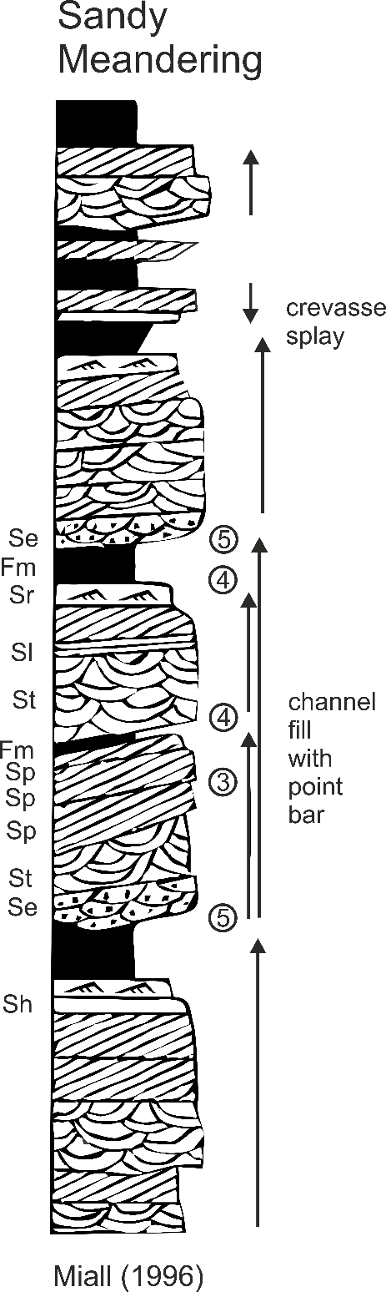
FAKTS facies model for sandy meandering systems
FAKTS facies models
These models contain the type of information seen in traditional facies models, but have a number of notable advantages:
quantitative information;
relatively objective process of synthesis of information from individual case studies into the model;
ability to tailor the models on system parameters, architectural properties, and/or scale of observation;
Colombera et al.
(2013, Sedimentology)

Slide 16
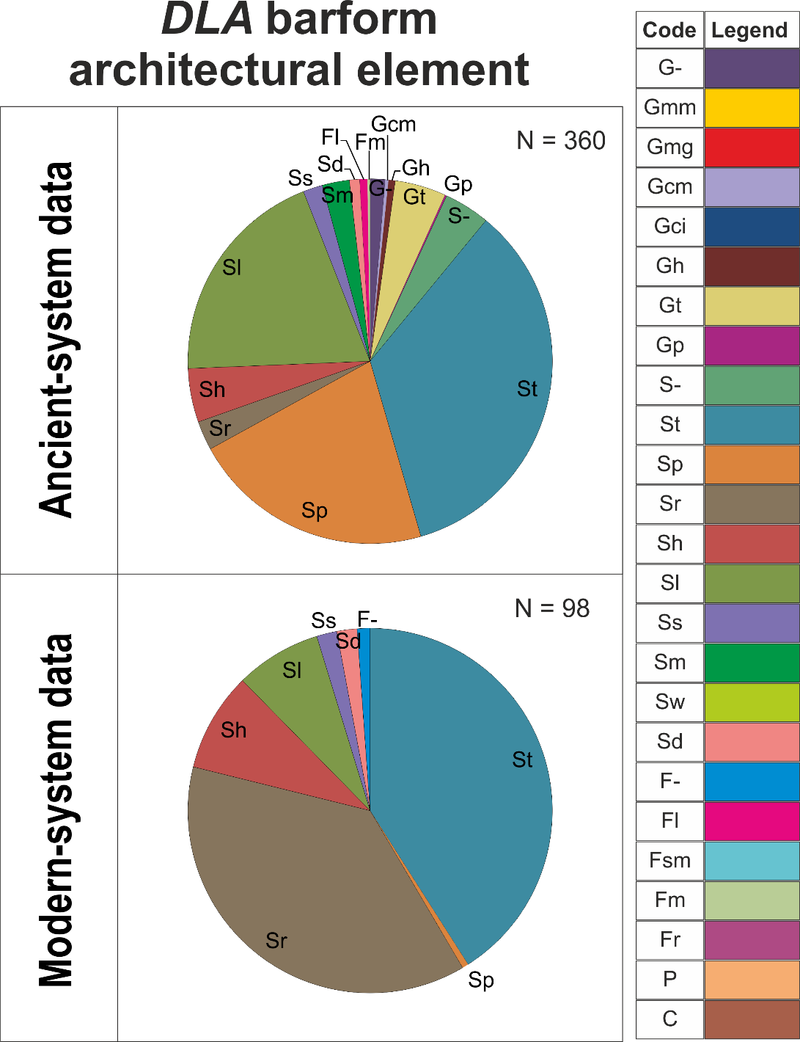
FAKTS facies models
inclusion of information on the uncertainty related to variability in data quality, and data deficiency;
inclusion of information on the uncertainty related to sedimentological variability seen in systems of same type;
possibility to consider ancient and modern systems as a way to constrain interpretational and preservational biases.
▼ ▼ ▼ ▼ ▼ ▼ ▼ ▼ ▼ ▼ ▼ ▼
Quantitative facies models as composite analogues for subsurface studies.
Colombera et al.
(2013, Sedimentology)

Slide 17
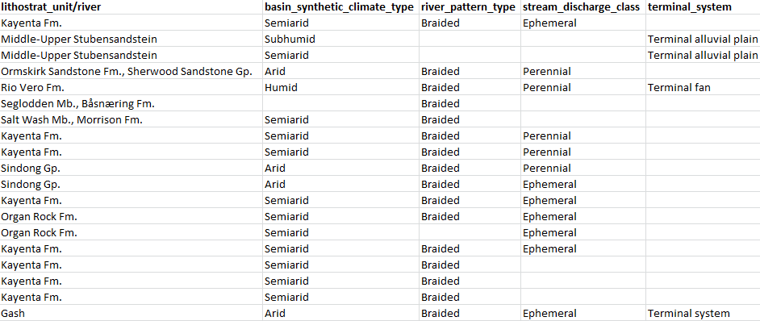
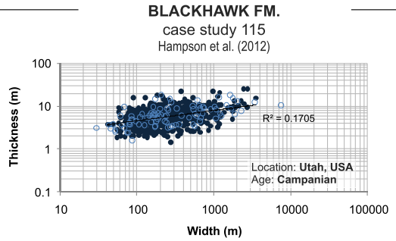
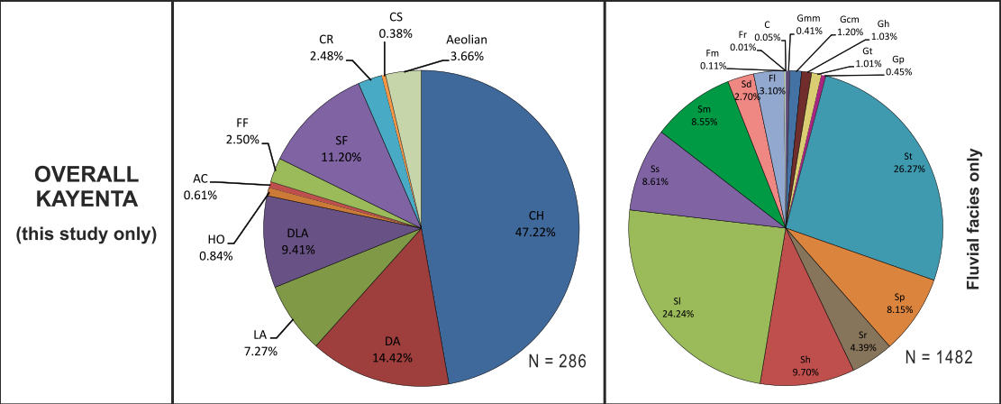
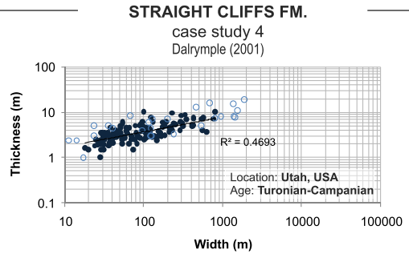
FAKTS analogue selection
347 case studies
160+ ancient succession, 130+ rivers
92,000+ classified genetic units:
15,000+ classified depositional elements
17,000+ classified architectural elements
60,000+ classified facies units
Analogy on depositional-system type
Analogy on sedimentological characteristics

Slide 18
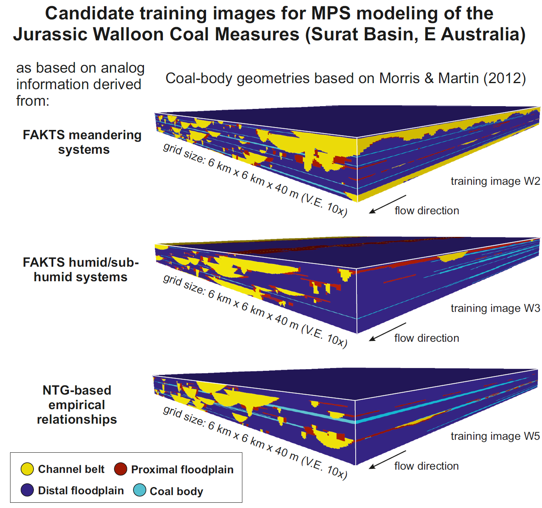
Subsurface applications of FAKTS
Analogues, and database facies models that act as composite analogues, can be used in subsurface studies for:
Guidance to subsurface interpretations
Prediction of subsurface heterogeneities and depositional geometries
Assisting sandbody well correlation
Conditioning of reservoir models

Slide 19
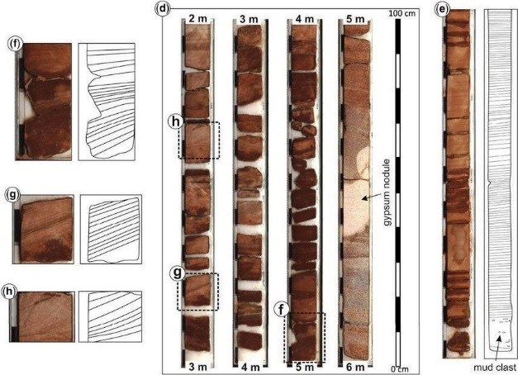
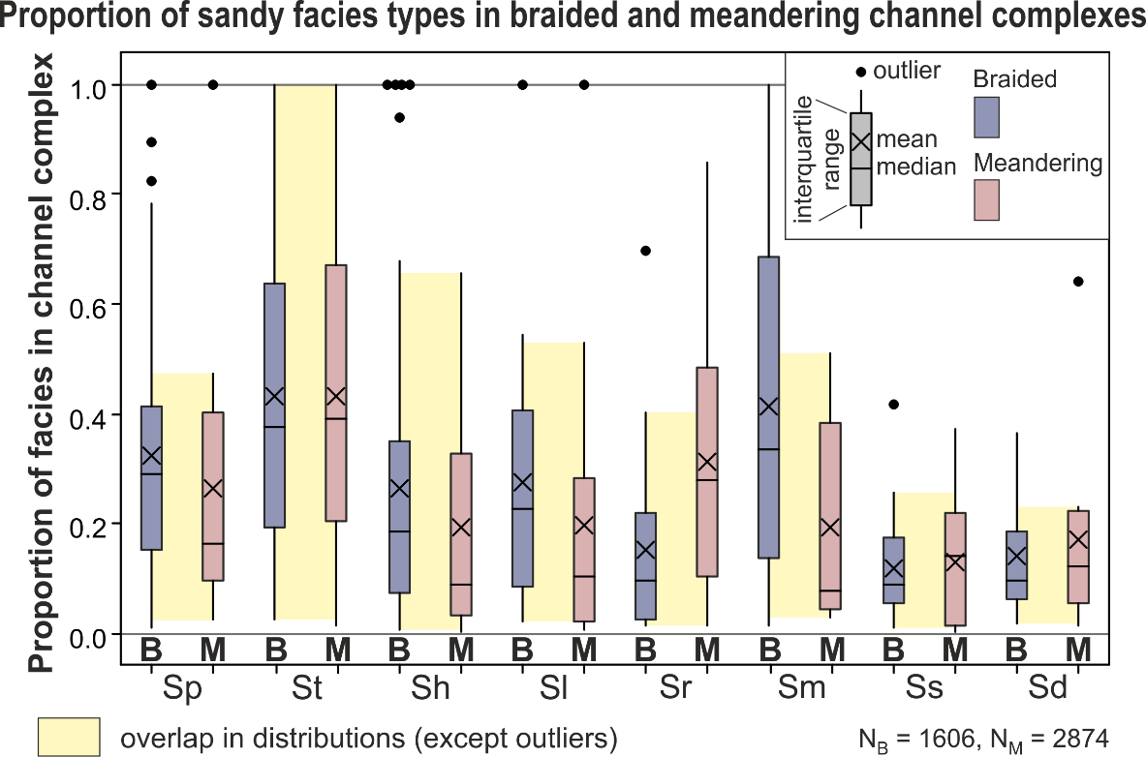
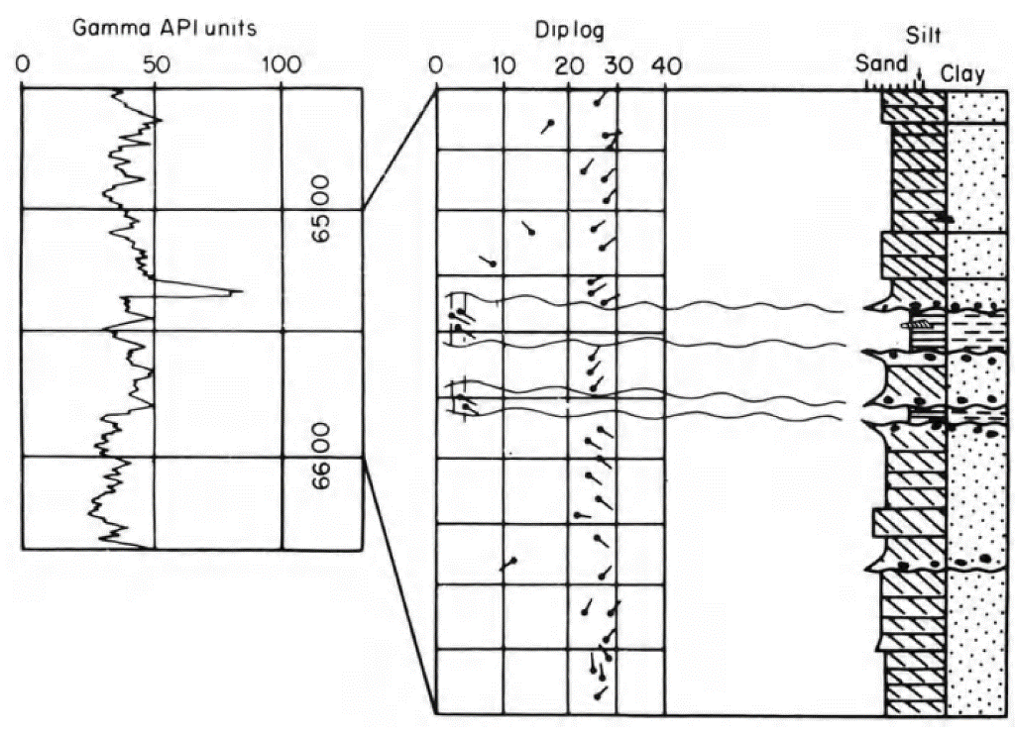
Subsurface applications of FAKTS
Yeste et al. (2018)
Guiding interpretations and erection of conceptual reservoir models
Support core interpretations with comparison of facies organization of classes of sedimentary bodies against FAKTS analogues.
‘Braided’
fluvial system
Selley (1996)

Slide 20
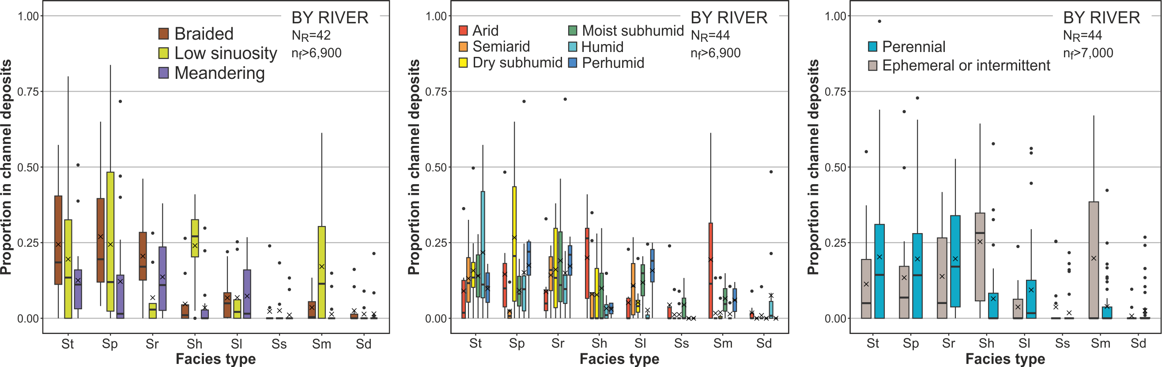
Subsurface applications of FAKTS
Guiding interpretations and erection of conceptual models
Support core interpretations with comparison of facies organization of classes of sedimentary bodies against FAKTS analogues.
Colombera & Mountney (2019, Sed. Geol.)

Slide 21
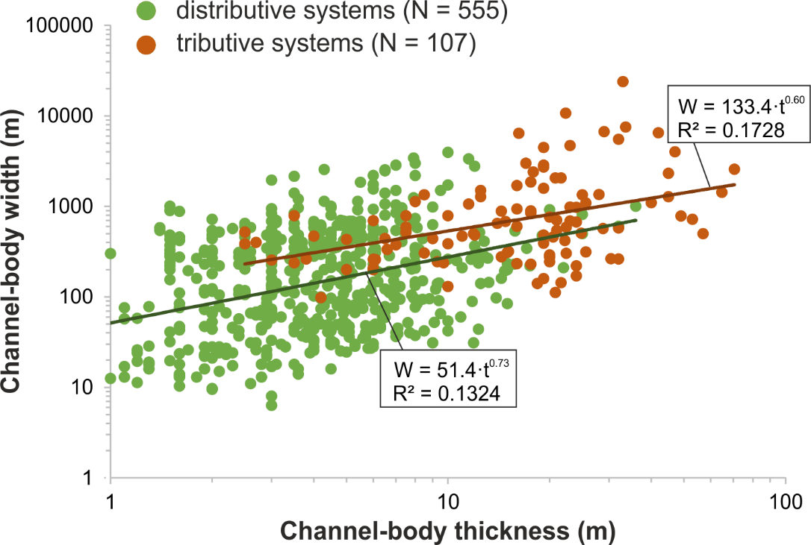
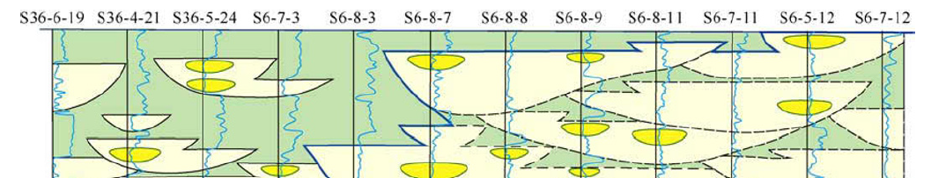

Subsurface applications of FAKTS
Assisting fluvial-sandstone well-to-well correlations
Derivation of empirical relationships to be used as constraints to well correlations, and more generally as predictive models of subsurface architecture.
He et al. (2013)

Slide 22
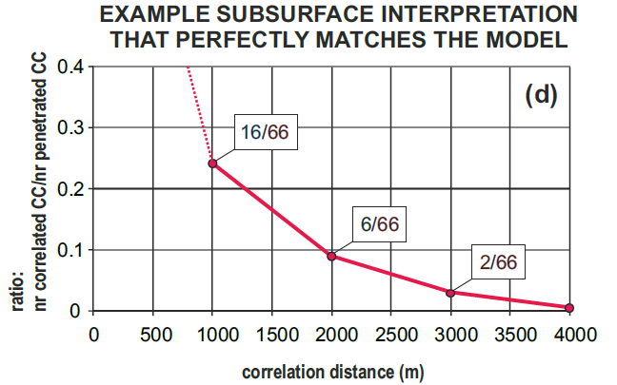
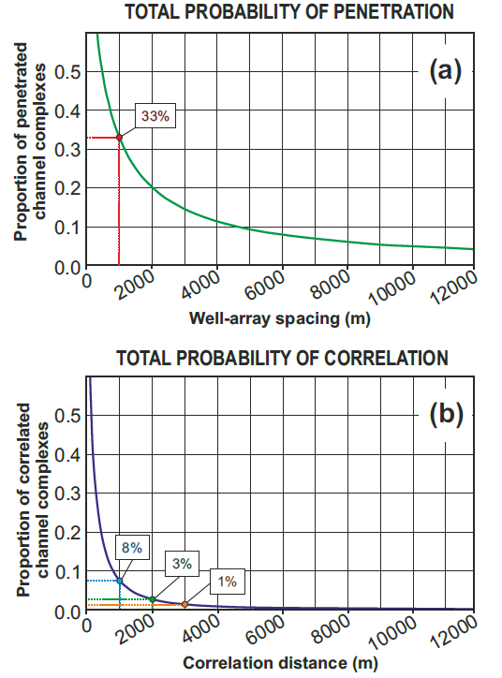
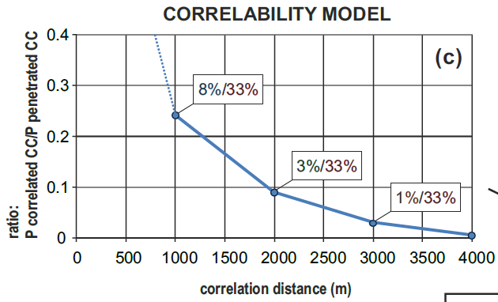
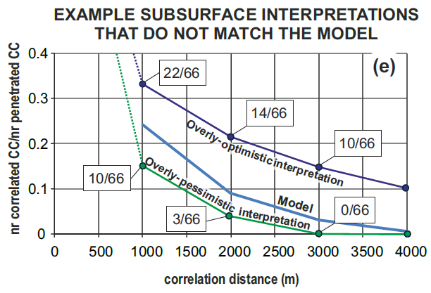
Subsurface applications of FAKTS
Assisting fluvial-sandstone well-to-well correlations
Derivation of ‘correlability models’, which express the likely proportion of penetrated units that are correlatable over a given distance.
saidbisd
Colombera et al. (2014, AAPG Bull.)
Total probabilities consider the variance in lateral extent of sedimentary bodies.

Slide 23
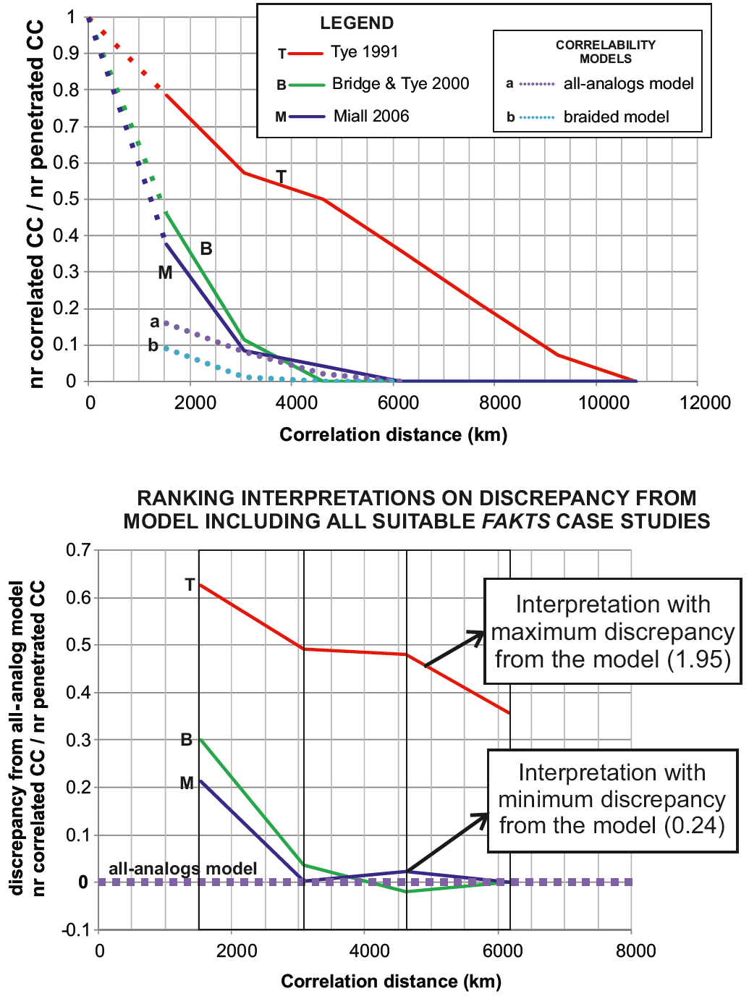
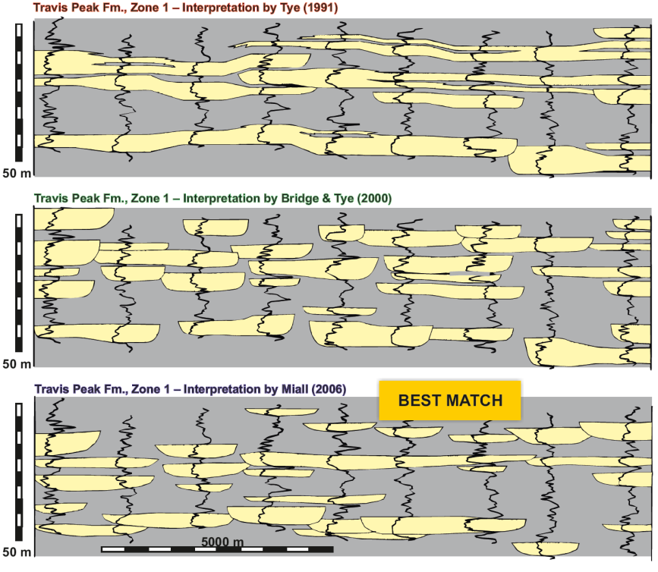
Subsurface applications of FAKTS
Assisting fluvial-sandstone well-to-well correlations
Derivation of ‘correlability models’, which express the likely proportion of penetrated units that are correlatable over a given distance.
Colombera et al.
(2014, AAPG Bull.)
Comparisons with correlability models quantify the geological likelihood of a correlation panel and tell us how to improve it.

Slide 24
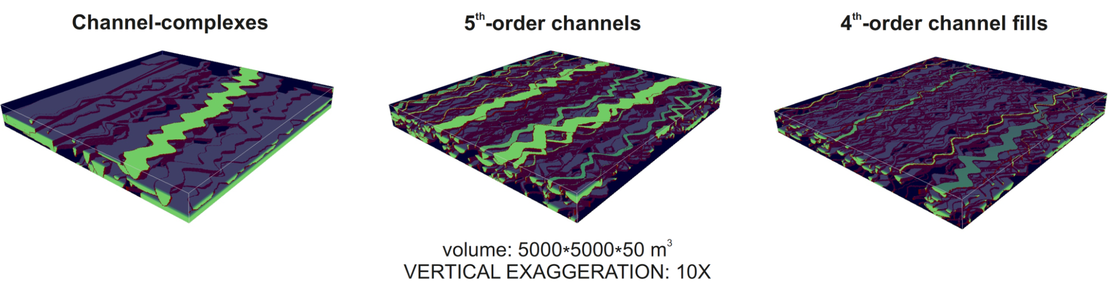
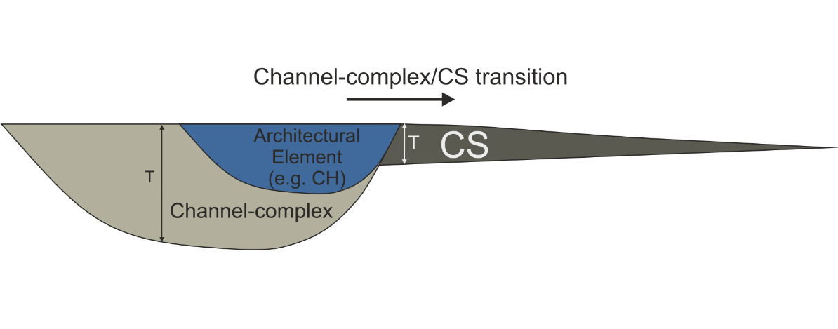

Subsurface applications of FAKTS
Conditioning of stochastic fluvial reservoir models: object-based approaches
Derivation of analogue-based parameters for constraining object-based models: absolute and relative dimensional parameters.
Workflows and applications in Colombera et al. (2012, AAPG Bull.)

Slide 25
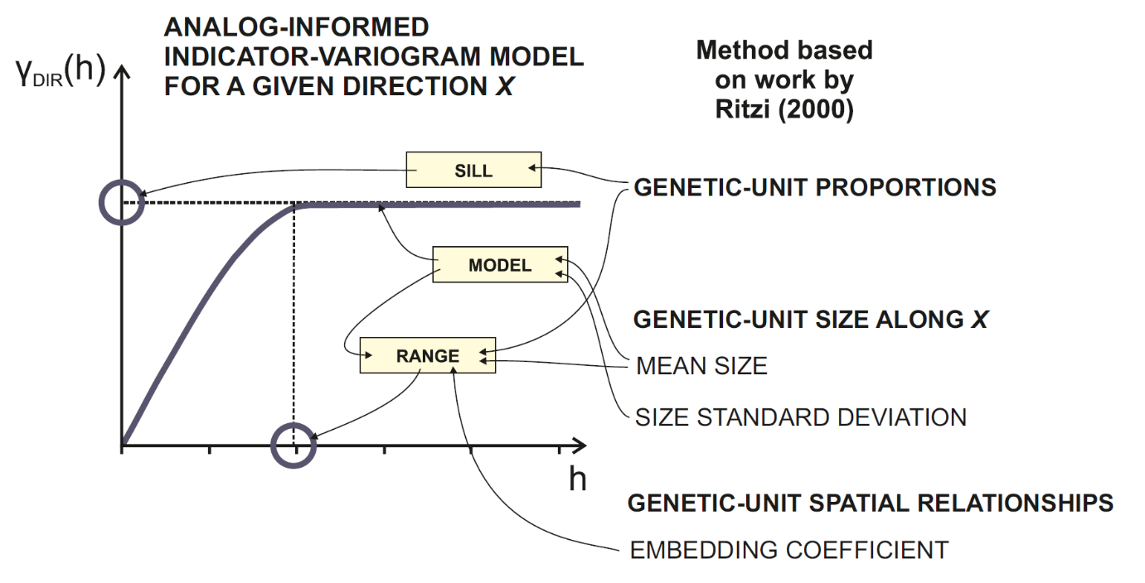

Subsurface applications of FAKTS
Conditioning of stochastic fluvial reservoir models:
pixel-based approaches
Derivation of analogue-based parameters for constraining object-based models: indicator auto- and cross-variogram models, transition statistics.
To condition models generated by:
SIS,
Plurigaussian simulations,
Markov-chain simulations,
MPS simulations.
Colombera et al.
(2012, 2016, AAPG Bull.)

Slide 26





Subsurface applications of FAKTS
Conditioning of stochastic fluvial reservoir models:
pixel-based approaches
Channel-element lateral (cross-stream)
transition count matrix
Derivation of analogue-based parameters for constraining object-based models: indicator auto- and cross-variogram models, transition statistics.
To condition models generated by:
SIS,
Plurigaussian simulations,
Markov-chain simulations,
MPS simulations.

Slide 27

Subsurface applications of FAKTS
Conditioning of stochastic fluvial reservoir models: MPS training images
Modelled point-bar
architecture
Derivation of analogue-based parameters for constraining geometric models of facies architecture, which can be applied as training images to condition MPS models of fluvial reservoirs.
FAKTS
Training images
Yan et al. (2017)
MPS
algorithms
Montero et al. (in review)

Slide 28



Subsurface applications of FAKTS
Empirical characterization of analogues: derivation of predictive rules
Compound analysis of multiple analogues for establishing quantitative predictive rules.
Example applications to:
Predictions of net-to-gross ratios and heterogeneity.
Arang Fm.
West Natuna Basin
Maynard et al. (2003)

Slide 29


Subsurface applications of FAKTS
Empirical characterization of analogues: derivation of predictive rules
Compound analysis of multiple analogues for establishing quantitative predictive rules.
Example applications to:
Predictions of crevasse-splay sandbody connectivity.
See presentation:
FRG Doc ID 1597

Slide 30


Subsurface applications of FAKTS
Empirical characterization of analogues: derivation of predictive rules
(i) for object-based reservoir models.
Compound analysis of multiple analogues for establishing quantitative predictive rules.
Example applications to:
Defining default values for geostatistical modelling.
Colombera et al. (2019, AAPG Bull.)

Slide 31


Subsurface applications of FAKTS
Empirical characterization of analogues: derivation of predictive rules
(ii) for variogram-based reservoir models.
Compound analysis of multiple analogues for establishing quantitative predictive rules.
Example applications to:
Defining default values for geostatistical modelling.
Colombera et al.
(2016, AAPG Bull.)

Slide 32


Subsurface applications of FAKTS
Empirical characterization of analogues: derivation of predictive rules
Example: assessment of architectural styles and point-bar compartmentalization in meanderbelts.
Probabilistic estimation of the proportion of point-bar, potential compartments, that are not yet intersected by a well array as a function of well spacing.
Colombera et al. (2017, MPG)
Shan et al. (2018)

Slide 33


Subsurface applications of FAKTS
Empirical characterization of analogues: derivation of predictive rules
Example: assessment of architectural styles and point-bar compartmentalization in meanderbelts.
Probabilistic estimation of the proportion of point-bar, potential compartments, that are not yet intersected by a well array as a function of well spacing.
On the basis of principles of geometric probability and relationships between bar and mud-plug thickness, the maximum admissible volume for unpenetrated compartments can be estimated.
Colombera et al. (2017, MPG)

Slide 34
Summary
A database of sedimentological data from classified fluvial systems allows:
storing, identifying and retrieving modern and ancient analogues to fluvial reservoirs;
generating quantitative fluvial facies models, distilled from several real-world depositional systems → composite analogues.
▼ ▼ ▼ ▼ ▼ ▼ ▼ ▼ ▼ ▼ ▼ ▼
The approach facilitates the application of analogues:
in subsurface studies, for:
  guiding interpretations of subsurface data,
  predicting architecture to inform practice in exploration and production,
  assisting sandbody well correlation,
  conditioning reservoir models;
in fundamental research, aiming to establish process-response models used in hydrocarbon E&P.

Slide 35
Selected references
Description of database concepts, design and outputs
Colombera L., Mountney N.P. & McCaffrey W.D. (2012) A relational database for the digitization of fluvial architecture: concepts and example applications. Petroleum Geoscience, 18, 129-140.
Database applications for reservoir modelling
Colombera L., Felletti F., Mountney N.P. & McCaffrey W.D. (2012) A database approach for constraining stochastic simulations of the sedimentary heterogeneity of fluvial reservoirs. AAPG Bulletin, 96, 2143-2166.
Colombera L., Mountney N.P., Howell J.A., Rittersbacher A., Felletti F. & McCaffrey W.D. (2016) A test of analog-based tools for quantitative prediction of large-scale fluvial architecture. AAPG Bulletin, 100, 237-267.
Colombera L., Mountney N.P., Medici G., & West L.J. (2019) The geometry of fluvial channel bodies: Empirical characterization and implications for object-based models of the subsurface. AAPG Bulletin, 103, 905-929.
Database application for sedimentological facies models
Colombera L., Mountney N.P. & McCaffrey W.D. (2013) A quantitative approach to fluvial facies models: methods and example results. Sedimentology, 60, 1526-1558.
Colombera L., & Mountney N.P. (2019) The lithofacies organization of fluvial channel deposits: a meta-analysis of modern rivers. Sedimentary Geology, 383, 16-40.
Database application for quantitative reservoir characterization
Colombera L., Mountney N.P., Felletti F. & McCaffrey W.D. (2014) Models for guiding and ranking well-to-well correlations of channel bodies in fluvial reservoirs. AAPG Bulletin, 98, 1943-1965.
Colombera L., Mountney N.P., & McCaffrey W.D. (2017) Geometry and compartmentalization of fluvial meander-belt reservoirs at the bar-form scale: quantitative insight from outcrop, modern and subsurface analogues. Marine and Petroleum Geology, 82, 35-55.

Slide 36
FAKTS: database access
Sponsors may access FAKTS in the following ways:
Using the web-based interface available on the FRG website (for active sponsors only)
  Enables basic queries on depositional and architectural element geometries and transitions
  Limited set of filters
  https://frg.leeds.ac.uk/fakts.html
By liaising with FRG staff
  We can provide selected database outputs
  Contact me at l.colombera@leeds.ac.uk
Through PDS Ava Clastics (for Ava customers)
  Graphical interface with charting capability – portal
  Seamless integration with reservoir-modelling tools of Schlumberger Petrel – plug-in
  Commercial product; licenses are not offered as part of FRG membership
  https://pds.group/ava-clastics/

Slide 37


Web-accessible front end
Easy to use,
limited capability
of query:
depositional and architectural elements currently included;
dimension and transition data made available;
limited number of filters.

Slide 38

Web-accessible front end
Go to: http://frg.leeds.ac.uk/

Slide 39

Web-accessible front end
Log in to ‘Sponsors’ Pages’

Slide 40

Web-accessible front end
Select ‘FAKTS Database’ from left-hand panel

Slide 41

Web-accessible front end
The menu-driven front-end can be accessed from the same page.

Slide 42

Web-accessible front end
Queries can be formulated and run from this page.

Slide 43
Web-accessible front end
(1) the scale of observation (scale of genetic unit) should be chosen from the right-hand panel.

Slide 44

Web-accessible front end
Let’s say we are interested in large-scale depositional elements.

Slide 45

Web-accessible front end
The number in brackets under the genetic-unit type tells us that 46 studies contain information at the depositional-element scale.

Slide 46
Web-accessible front end
(2) the type of output (i.e. geometry or transition data) we are interested in should be selected next.

Slide 47

Web-accessible front end
Let’s say we are interested in obtaining dimensional parameters.

Slide 48
Web-accessible front end
Now we can filter the database on the parameters on which the depositional systems are classified (lower right-hand panel).

Slide 49
Web-accessible front end
(3) Let’s say we are interested only in data from convergent tectonic settings.

Slide 50

Web-accessible front end
(3) let’s say we are interested only in data from convergent tectonic settings: we get 22 case studies now.

Slide 51
Web-accessible front end
(4) now, we want to further filter the database by selecting only systems from subhumid environments.

Slide 52

Web-accessible front end
(4) now, we want to further filter the database by selecting only systems from subhumid environments.

Slide 53

Web-accessible front end
11 case studies are now left.

Slide 54

Web-accessible front end
11 case studies are now left: here you see them listed.

Slide 55
Web-accessible front end
(5) let’s say that we want to exclude modern-river data from the South Saskatchewan: just click on (Remove) in its box.

Slide 56

Web-accessible front end
A summary of the filters applied and case studies considered is presented at the top of the central panel.

Slide 57
Web-accessible front end
(6) now we can select the type of depositional element (channel-complex or floodplain) for which we want dimensional data.

Slide 58

Web-accessible front end
(6) now we can select the type of depositional element (channel-complex or floodplain) for which we want dimensional data.

Slide 59
Web-accessible front end
(7) now we only need to click on ‘download’ to obtain the Excel spreadsheet with the filtered channel-complex output.

Slide 60

Web-accessible front end
The Excel spreadsheet with FAKTS output can now be opened or downloaded for analysis of channel-complex geometries.

